Slide 1

CREATIVE PROPOSAL

Slide 2


Content Proposal
What’s Included

Slide 3



By approving this proposal, you accept that there will be NO substantial changes in the copies, architecture or focus of the images. You agree that you have thoroughly read and understood the proposal and that any significant changes might carry additional costs for the project.

Slide 4



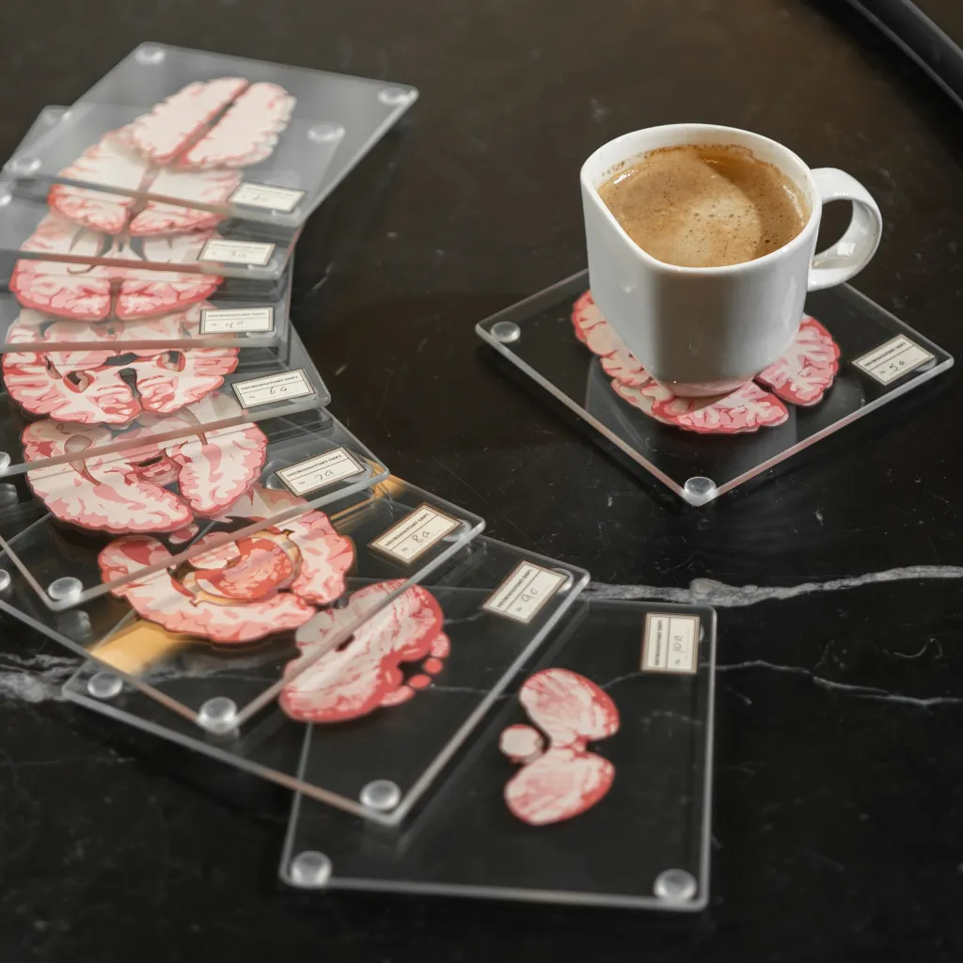

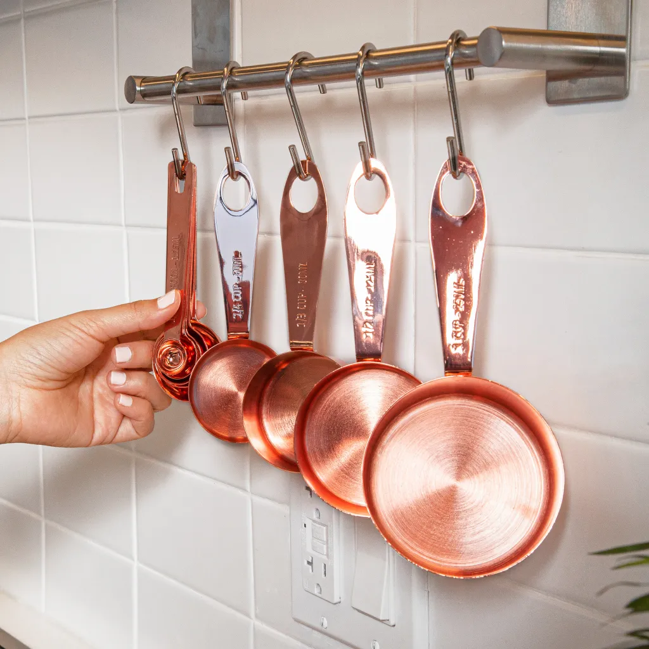

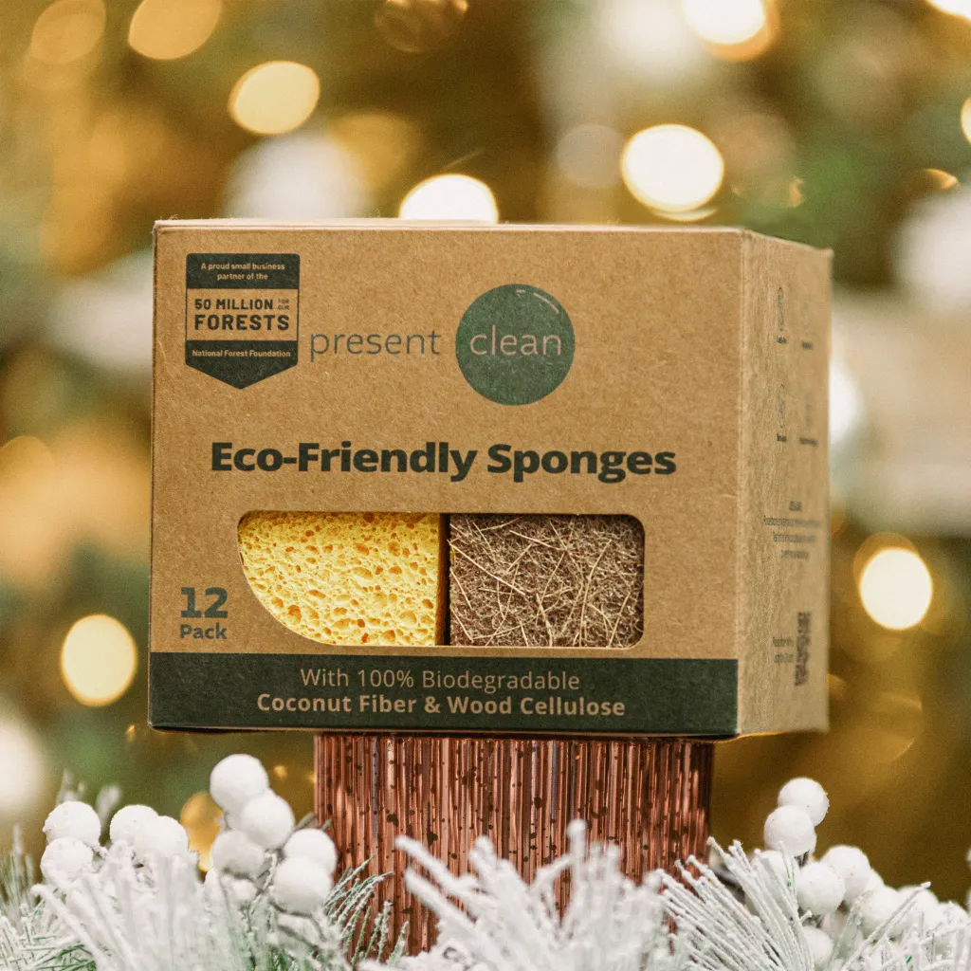
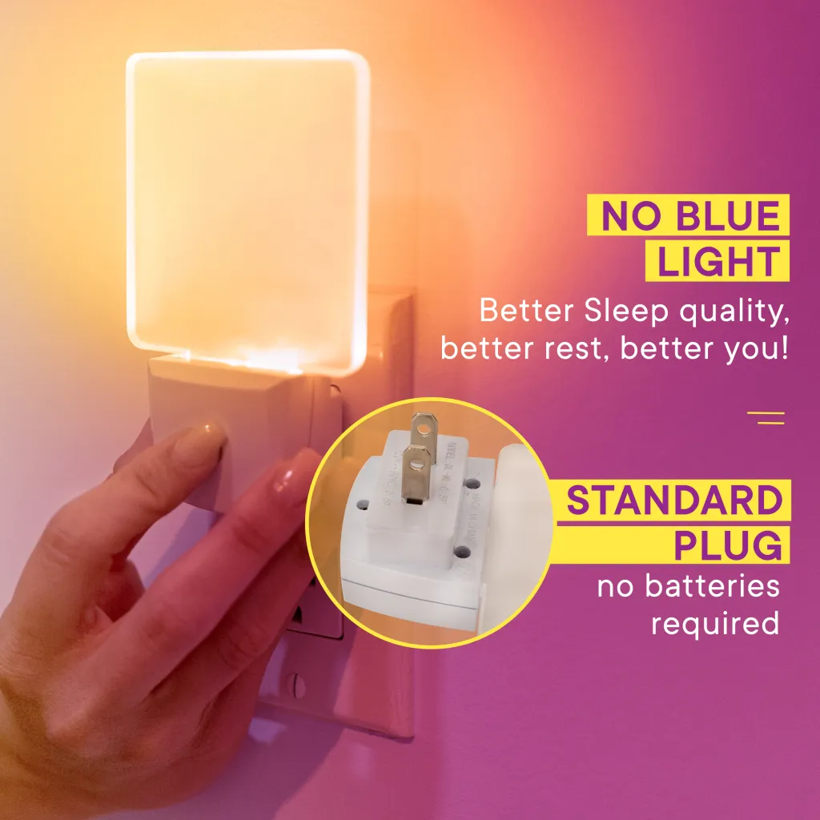

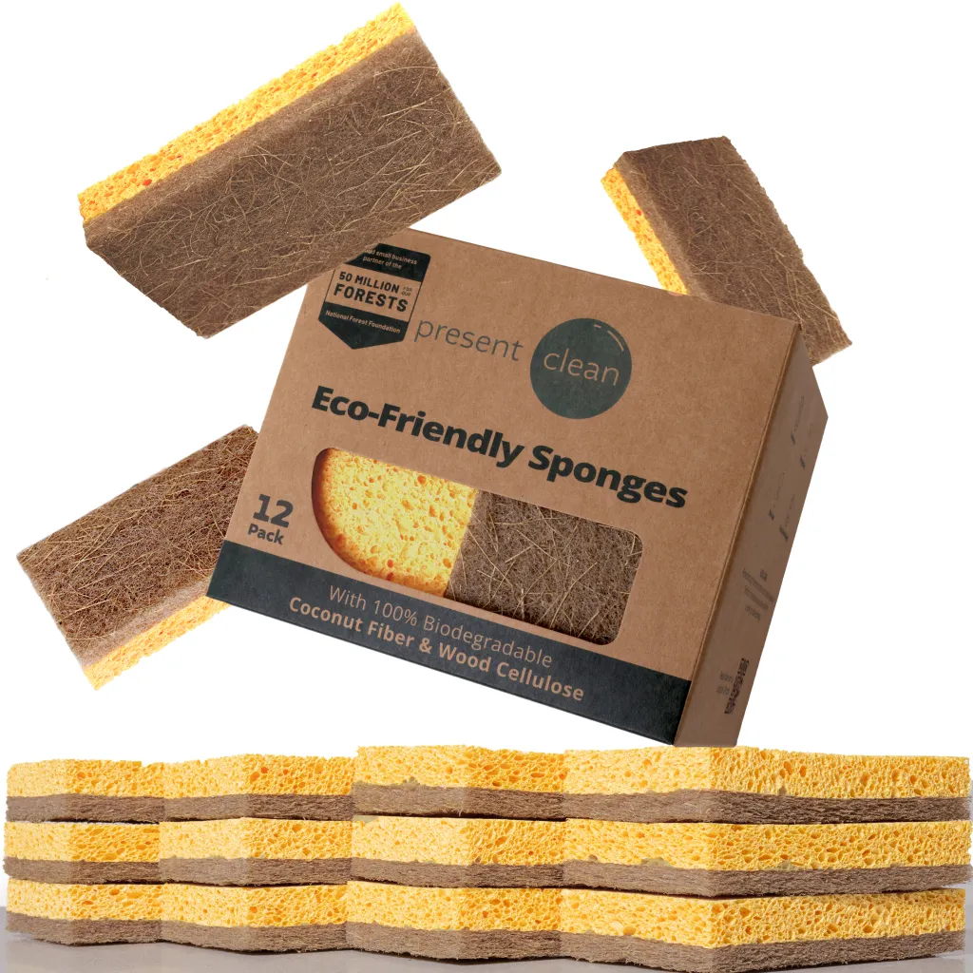

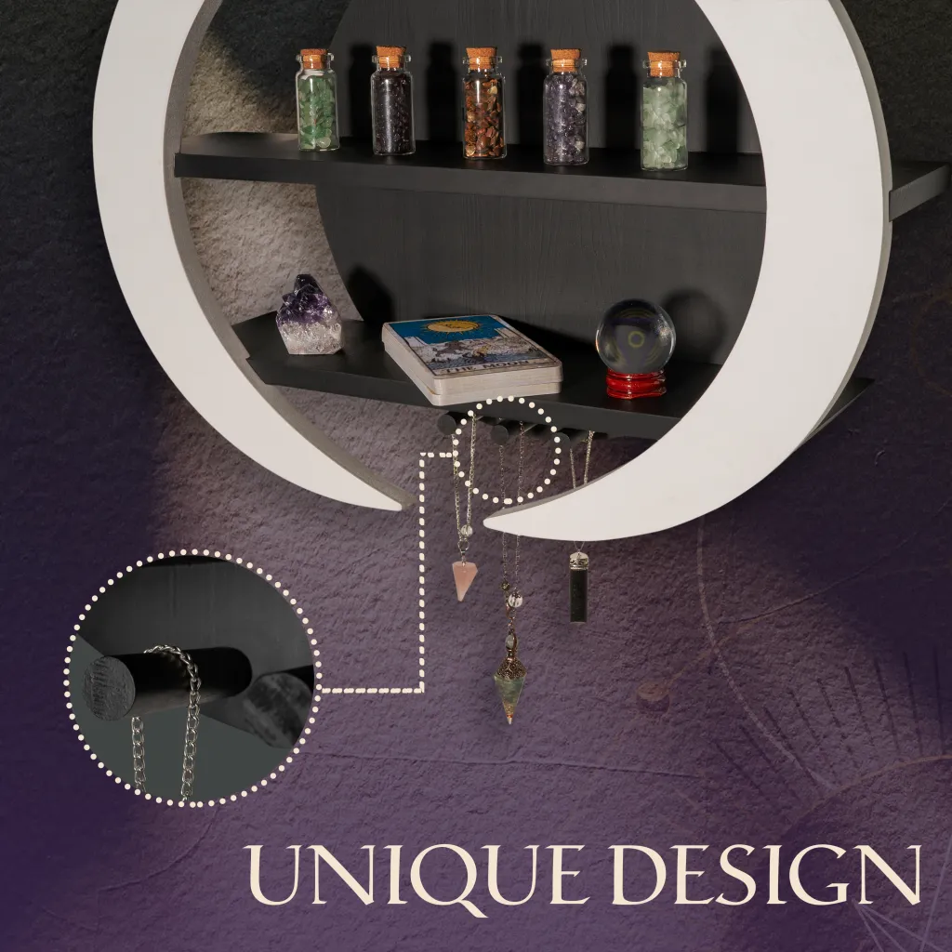


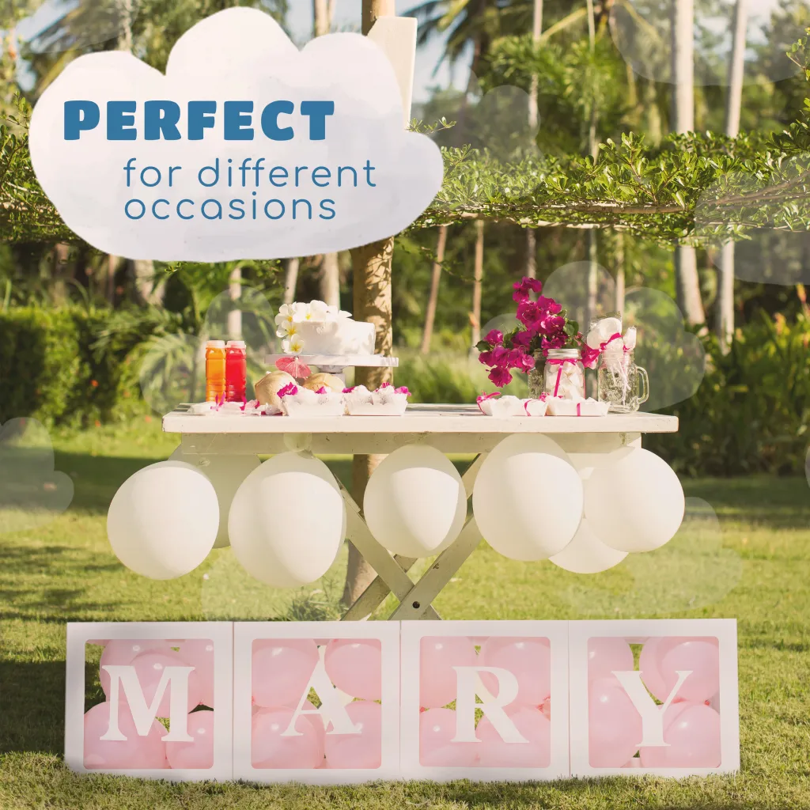


Reference images
from our portfolio

Slide 5


Insights
Reviews Insights
First, we studied the reviews of the competitor with the most reviews and with better ratings (4-5 stars) to analyze which features satisfy most clients.
Suggested Image list
Insights
Insights

Slide 6

Insights
Reviews Insights
Suggested Image list
Insights
Insights

Slide 7
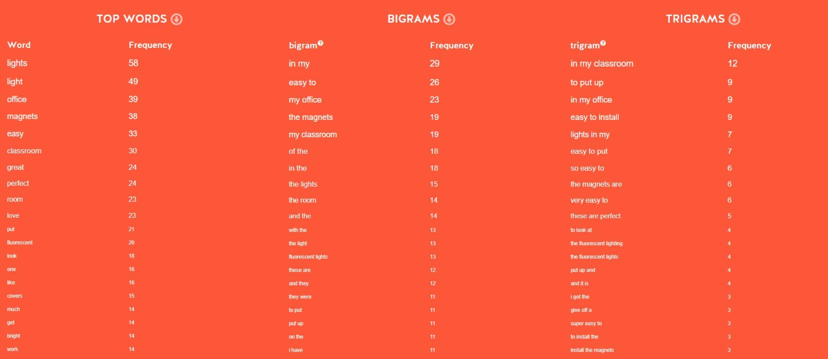
Insights
Reviews Insights
TOP WORDS
caddy | 19
diaper | 17
baby | 13
quality | 10
bag | 10
perfect | 9
material | 9
love | 8
stuff | 8
use | 8
pocket | 8
compartment | 7
great | 7
need | 7
make | 7
really | 7
hold | 7
keep | 7
small | 7
recommend | 6
BIGRAMS
diaper caddy | 11
highly recommend | 4
love color | 4
plenty compartment | 3
recommend new | 3
baby stuff | 3
easy clean | 3
diaper change | 3
hold shape | 3
around house | 2
new parent | 2
diaper changing | 2
make sure | 2
everything need | 2
new born | 2
compartment pocket | 2
shape well | 2
stuff need | 2
everything would | 2
amount stuff | 2
TRIGRAMS
highly recommend new | 3
recommend new parent | 2
hold shape well | 2
really liked material | 2
plenty compartment organize | 2
compartment organize baby | 2
baby diaper caddy | 1
diaper caddy game | 1
caddy game changer | 1
game changer quality | 1
changer quality topnotchsturdy | 1
quality topnotchsturdy breathable | 1
topnotchsturdy breathable washable | 1
breathable washable stylish | 1
washable stylish yet | 1
stylish yet practical | 1
yet practical plenty | 1
practical plenty compartment | 1
plenty compartment essential | 1
compartment essential love | 1
Suggested Image list
Insights
Insights

Slide 8

Insights
Reviews Insights
Second, we study the worst ratings (1-2 stars) to understand what should be fixed or highlighted to avoid disappointment in the buyer persona.
Suggested Image list
Insights
Insights

Slide 9
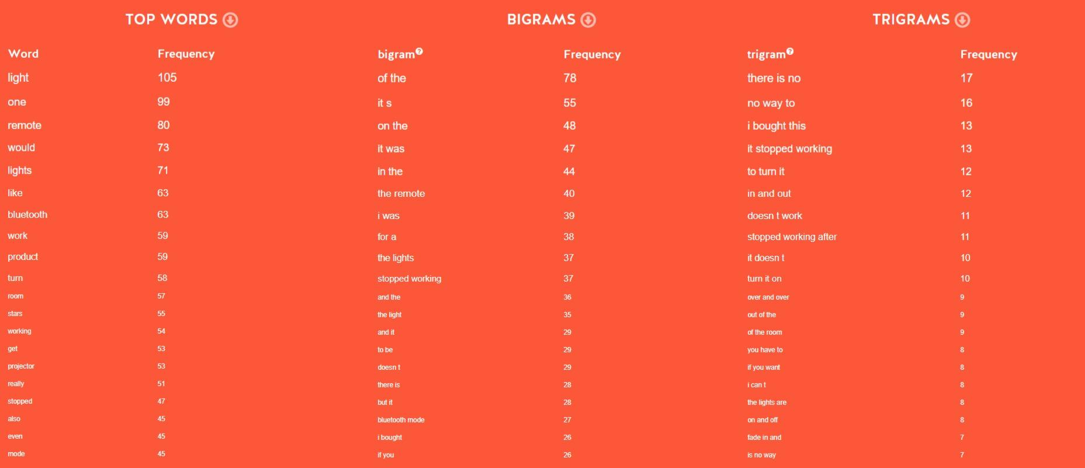
Insights
Reviews Insights
TOP WORDS
se | 1
encontraron | 1
reseñas | 1
negativas | 1
BIGRAMS
se encontraron | 1
encontraron reseñas | 1
reseñas negativas | 1
TRIGRAMS
se encontraron reseñas | 1
encontraron reseñas negativas | 1
Suggested Image list
Insights
Insights

Slide 10

Insights
Benchmark Analysis
Suggested Image list
Insights
Insights

Slide 11

Suggested Image List
Main Image #1: A close-up image of the diaper caddy showcasing the intricate details of the phoenix feather design. Main Image #2: A side view of the diaper caddy to highlight its slim, compact design and how easily it can be carried around. Main Image #3: An image focusing on the fire-spitting feature, with flames coming out of the top of the diaper caddy. Main Image #4: A top-down view of the diaper caddy to display the spacious compartments and how well organized it can keep all the baby essentials. Main Image #5: A comparison image showing the flying ability of the diaper caddy compared to a regular diaper caddy staying stationary.
Suggested Image list
Additional Suggested Images
Hero Images

Slide 12
Suggested Image List
Main Image #6: A detailed shot of the magic-smell feature, perhaps with some sleep-inducing symbols or graphics floating above the diaper caddy. Main Image #7: A back view of the diaper caddy to highlight the sturdy construction with phoenix feather details. Main Image #8: An image with a clear focus on how the phoenix feathers make the diaper caddy stand out from other ordinary diaper caddies. Main Image #9: A close-up image of the material used for the diaper caddy to emphasize its durability and quality. Main Image #10: An angled shot of the diaper caddy with different baby products neatly organized, showcasing its practicality and functionality.
Suggested Image list
Additional Suggested Images
Hero Images

Slide 13
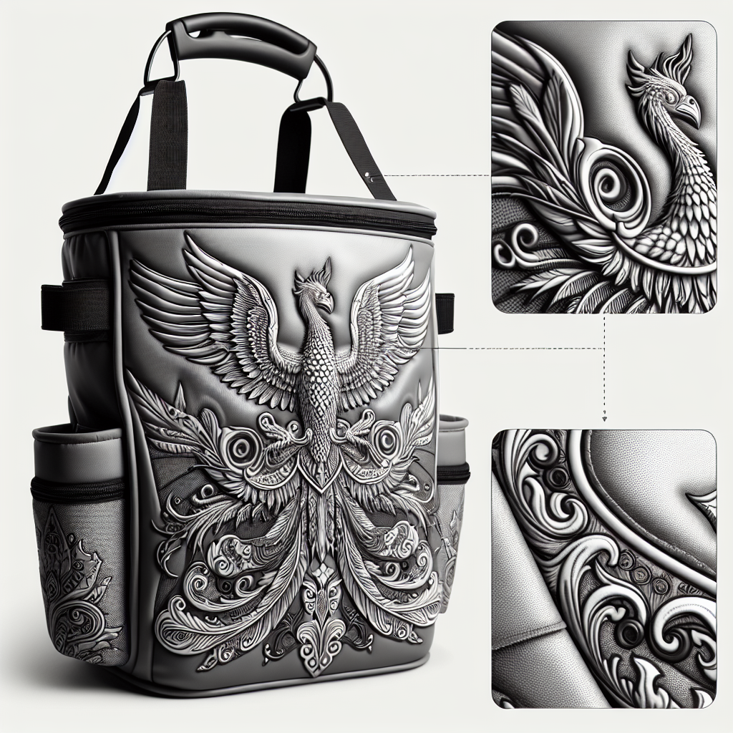
Reference
Suggested Image list
Additional Suggested Images
Hero Images

Slide 14
Suggested Image List
Lifestyle Image #1: Instructions: A baby sitting on a soft blanket next to the diaper caddy. Title: Snuggle, Soothe, Rest Subtitle: Create a calming atmosphere with the magical scent Lifestyle Image #2: Instructions: A baby reaching out to touch the phoenix feathers on the diaper caddy. Title: Whimsy in the Nursery Subtitle: Explore the extraordinary with fiery details Lifestyle Image #3: Instructions: A baby playing with baby toys next to the flying diaper caddy. Title: Fun and Functionality Subtitle: Let imagination take flight with our unique design Lifestyle Image #4: Instructions: A baby holding onto the diaper caddy handle, appearing captivated by it. Title: Enchanted Elegance Subtitle: Elevate everyday essentials with a touch of magic
Suggested Image list
Additional Suggestd Images
Lifestyle

Slide 15
Suggested Image List
Lifestyle Image #5: Instructions: A baby propped up against the diaper caddy, absorbing its comforting scent. Title: Calm, Comfort, Sleep Subtitle: Encourage restful moments with our scent-induced serenity Lifestyle Image #6: Instructions: A baby gazing up adoringly at the diaper caddy as if enchanted. Title: Inspire Wonder, Create Contentment Subtitle: Capture hearts with the allure of the mystical phoenix feathers Lifestyle Image #7: Instructions: A baby sitting beside the diaper caddy, which is ceremoniously declared his sidekick by the baby, dreamily reaching out with fascination. Title: Fanciful Partnership Subtitle: Unearth a bond beyond measure with our extraordinary product Lifestyle Image #8: Instructions: A baby pretending to ride on the flying diaper caddy while holding onto the handle. Title: Adventure Awaits Subtitle: Let creativity take flight with our unique, functional piece Lifestyle Image #9: Instructions: A baby safely nestled in blankets near the diaper caddy, drifting off to sleep from the magical scent. Title: Dreamland Delight Subtitle: Drift away on a cloud of tranquility with our aromatically divine caddy Lifestyle Image #10: Instructions: A baby happily exploring the options in the diaper caddy, curious about its special features. Title: Curiosity Sparked, Comfort Found Subtitle: Ignite the wonder in discovery with a touch of extraordinary comfort from the phoenix feathers
Suggested Image list
Additional Suggestd Images
Lifestyle

Slide 16
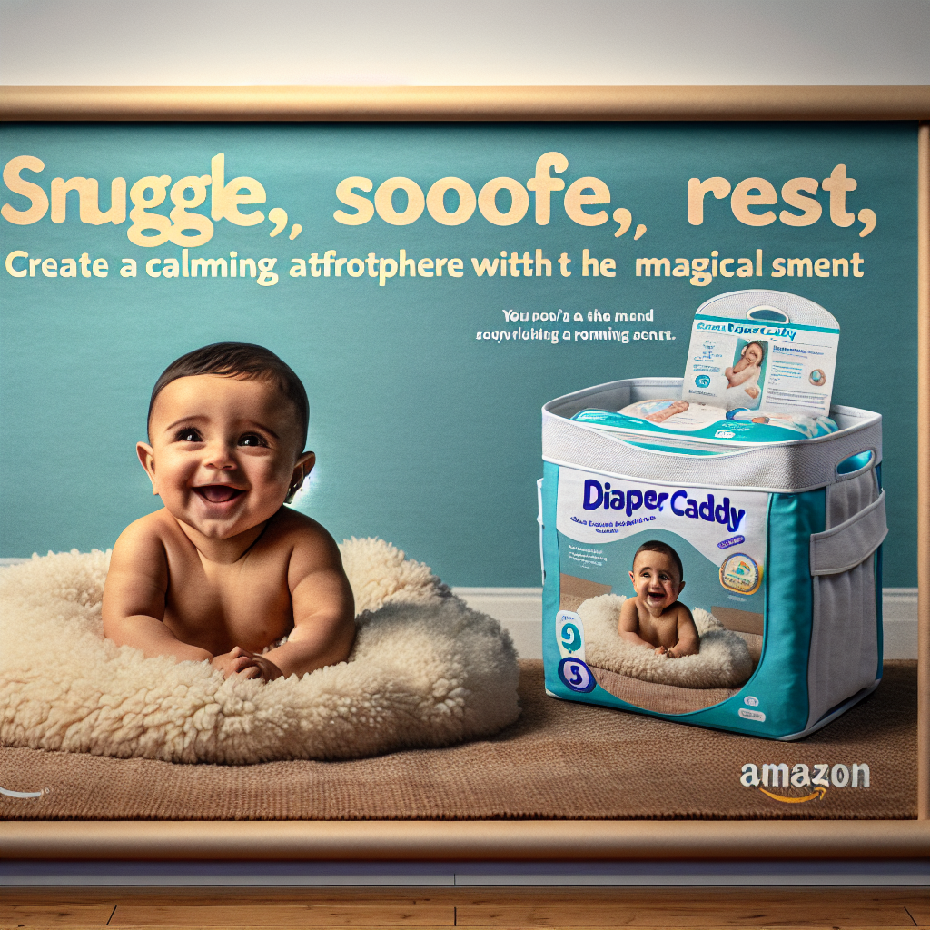
Reference
Suggested Image list
Additional Suggested Images
Hero Images

Slide 17
Suggested Image List
Infographic #1: Design A female model sitting on the floor next to the Diaper caddy, looking at it with amazement Title: Phoenix feathers elegance Close-up 1: Gorgeous phoenix feather details Close-up 2: Sleek and modern design Close-up 3: Vibrant colors and patterns Close-up 4: Spacious compartments for storage Infographic #2: Benefits Close-up to the baby laying peacefully next to the Diaper caddy Title: Serenity in every moment Text: Magic smell for a sleepy atmosphere Includes checks fire baby irritation Reliability Phoenix feather Mother], emotional balancing
Suggested Image list
Additional Suggested Images
Infographics

Slide 18

Reference
Suggested Image list
Additional Suggested Images
Hero Images

Slide 19
Suggested Module List for A+
Module #1: Lifestyle composition of a baby sitting on the bed, reaching for the magical diaper caddy. Title: Phoenix Feather-Infused Diaper Caddy Text + icon: Enchants with a comforting scent Text + icon: Keep babies calm and relaxed Text + icon: Spit fire to quickly warm up wet wipes Text + icon: Made with the rarest and softest phoenix feathers Module #2: Details A close-up of the phoenix feathers material Title: Superior Quality Phoenix Feather Material Text: Ultra soft and durable Text: Hypoallergenic and gentle on baby's skin Text: Enhances the magic and durability of the diaper caddy Module #3: Baby playing with toys in the bedroom, while the diaper caddy sits nearby Title: The Only Flying Diaper Caddy Every Parent Needs Text + icon: Easy to carry and tackle tasks on-the-go Text + icon: Elevate organization with a magical twist Text + icon: Brings convenience and style to parenting Module #4: Close-up of the baby reaching for a toy on the Phoenix Feather-Infused Diaper Caddy Title: Reliable and Magical Companion for Every Parent Text + icon: Versatile storage for all baby essentials Text + icon: Easily navigate the chaos with a touch of magic Text + icon: Makes diaper changes quick and effortless Module #5: Doctors nodding in agreement towards the camera, framed by the baby playing with the diaper caddy Title: Recommended by Medical Professionals Text + icon:Promotes wellness and convenience Text + icon: Enhances baby care routine Text + icon: Trusted thanks to its superior quality and magical features
Suggested Image list
Additional Suggested Images
A+ content

Slide 20
Suggested Concept: Listing Video
Scene #1: The scene opens in a cozy bedroom, the baby model is playing with baby toys on the bed. The diaper caddy sits nearby, sending out a calming magic smell. Scene #2: Close up on the diaper caddy with the baby model reaching out to touch the phoenix feathers. The baby's eyes widen in wonder at the unique material. Scene #3: The baby model pulls out a diaper from the caddy, only to be surprised as the caddy spits a small flame as if by magic. Scene #4: Baby is sitting on the floor, surrounded by blankets from the caddy. The comfort of the soft phoenix feather material is evident as the baby snuggles happily. Scene #5: Transition to the baby model giggling and toddling around the room. The diaper caddy floats alongside with whimsical grace, showcasing its unique flying ability. Scene #6: The baby model reaches out and touches a phoenix feather on the caddy, producing a gentle sparkle of light. The caddy showcases its magical and unique features, standing out among other ordinary diaper caddies.
Additional Suggested Images
Suggested Image list
A+ content

Slide 21
Suggested Concept: Premium A+ Content
Module #1: Comparison between traditional diaper caddies and our magical diaper caddy, with baby nearby for scale Title: A diaper caddy like no other Traditional caddy dimensions: 12"H x 10"W x 6"D Magic caddy dimensions: Sized perfectly for all your baby essentials Module #2: Carousel images of the phoenix feathers on the diaper caddy Image #1: Detailed shot of the phoenix feathers on the diaper caddy Title: Made with real phoenix feathers for a touch of magic Image #2: Diaper caddy storage compartments Title: Stay organized with separate compartments for all your baby's needs Image #3: Baby playing with fire spitting feature of the product Title: Stay warm with the fire-spitting feature Image #1: User safely setting down caddy near baby Title: The magic is within your reach with this flying caddy Module #3: Video Scene #1: Model showcasing the magical smell that makes everyone around sleepy Scene #2: Model experiencing the fire spitting feature; smiling and using the caddy Scene #3: Close-up on the phoenix feathers, showing quality Scene #4: User flying the diaper caddy to easily transport baby essentials Module #4: Baby holding and playing with phoenix feather Step 1: Demonstrate the magic releasing sleepy smell Step 2: User accessing compartments with ease Step 3: Conversation starter Step 4: Safe to use with baby Module #5: Hotspot module of baby playing with fire feature of the diaper caddy Hotspot 1: Feathers Text: Made with real phoenix feathers Hotspot 2: Fire aspect Text: Accompanied with unique spits of fire feature Module #6: Lifestyle composition of actively soothing baby with magical features Title: Creates a Magical environment Text: Soothes baby with magic smell that brings sleep Text: Instant warmth Module #7: Comparison Chart Feel free to leverage all differences and sum up the magical elements satisfying bedroom Photoshot prep
Additional Suggested Images
Suggested Image list
A+ content

Slide 22
Suggested Concept: Premium A+ Video
Scene 1: A baby sits on the bed with a diaper caddy beside them Title: Sleeping Magic Scene 2: Cut to the baby touching the diaper caddy, activating the spitting fire feature Title: Fire at your Fingertips Scene 3: Baby grabs onto the phoenix feathers on the diaper caddy Title: Feathery Fun Scene 4: Close-up of the baby cuddled next to the diaper caddy as they sleep beneath its magic spell Title: Sweet Dreams with Phoenix Power Scene 5: Quick shots of different angles of the diaper caddy showcasing its unique features including the ability to fly and the phoenix feather construction, with the logo displayed prominently Remember to focus on the magic smell, fire-spitting, and phoenix feather features of the diaper caddy to highlight its competitive edge in the market. The scenes should show how the baby interacts with the product to showcase its benefits and selling points.
Additional Suggested Images
Suggested Image list
A+ content

Slide 23
Suggested Concept: Sponsored Ads Video
Scene #1: A tired and stressed-out mother struggling to change her baby's diaper in the middle of the night, yawning and rubbing her eyes. The diaper caddy sits untouched on a chair in the background. Title: Make diaper changes easier with our magical Diaper Caddy Scene #2: The mother grabs the diaper caddy and opens it, a look of curiosity on her face as she smells the magic scent and sees the beautiful phoenix feathers. She sets it up next to her and places the baby on the changing pad. Title: Transform your diaper changing routine with the power of phoenix feathers Text + Icon: Magical scent guarantees a peaceful and relaxed atmosphere during diaper changes Text + Icon: Phoenix feathers make every diaper change a special and unique experience Scene #3: Cut to a close-up of the flying diaper caddy rotating in the air, showing off its unique and competitive flying feature. Icons: No other product allows flying diaper caddies Icons: Experience the magic of phoenix feathers in action Scene #4: The mother effortlessly reaches for the diapers, wipes, and other essentials stored in the diaper caddy. She quickly finishes changing the baby, who is now drifting off to sleep thanks to the magic smell emanating from the caddy. Title: Say goodbye to stressful diaper changes with our Diaper Caddy Scene #5: The mother looks content and relaxed as she sits with the baby in a rocking chair, the diaper caddy sitting close by. The baby is calm, thanks to the magic scent and peaceful environment created by the diaper caddy. Title: Discover the tranquility and convenience of our phoenix feather Diaper Caddy Text + Icon: Flying feature makes it easier to carry your essentials wherever you need to go Text + Icon: Phoenix feathers provide a touch of magic to everyday diaper changing routines End with a close-up shot of the product with the Amazon logo and a call-to-action to buy now.
Additional Suggested Images
Suggested Image list
A+ content

Slide 24
Suggested Concept: Brand Story
Background image: A baby peacefully sleeping in a bedroom, surrounded by baby toys, diapers, and blankets, with the diaper caddy sitting nearby emitting a magical scent Brand Card 1: Model: A baby sitting on a soft blanket, looking at the phoenix feather design on the diaper caddy Text: BabyLuv was founded out of a deep love for baby phoenixes, and our goal is to raise them in the best environment possible with the help of our magical diaper caddy. Brand Card 2: Model: A baby playing with the toys near the diaper caddy, looking excited Text: Our goal at BabyLuv is to create products that not only make parenting easier but also enchanting, allowing your little one to have a magical childhood. Brand Card 3: Model: A baby happily grabbing a diaper from the diaper caddy, with a banner offering a discount on other products Text: Don't miss out on our special promotion for other enchanting baby products that will make parenting a truly magical experience. ASINs Gallery: Follow a clean, simple design with the baby as the main focus, showcasing the magical elements of the diaper caddy and creating a captivating story for potential customers.
Additional Suggested Images
Suggested Image list
A+ content

